Slide 1


SMART INDIA HACKATHON 2026
Problem Statement ID – SIH26027
Problem Statement Title- Al-Powered Automatic Block
Planning to Maximize Asset Availability for Train Operations
on Indian Railways
Theme- Transportation & Logistics
PS Category- Software
Team ID- 15
Team Name- Trailblazer

Slide 2
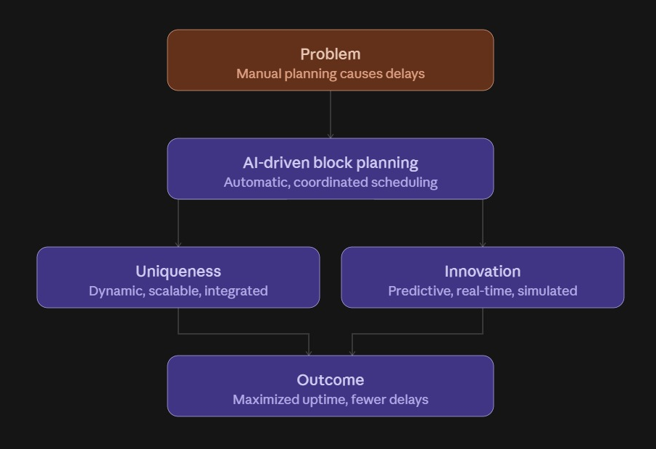
Automatic Block Planning System
Trailblazer

Slide 3
TECHNICAL APPROACH
Trailblazer
AI-Assisted Development with Human Validation
Technologies Used
Methodology
Backend & API Layer: Python with FastAPI (for High Performance).
AI Engine & Logic: Google Vertex AI (Gemini API) and Python-based OR-Tools.
Database: PostgreSQL extended with PostGIS for geospatial track sector matching.
Frontend UI: React with Tailwind CSS and Frappe Gantt for timeline rendering.
Step 1: Aggregate maintenance data and use AI to find overlapping track sectors.
Step 2: Merge department requests (Track, Signal) into parallel blocks to save time.
Step 3: Fit these optimized blocks into the Control Office's clear train windows.
Step 4: Output the synchronized schedule to a live, interactive Gantt dashboard.

Slide 4
FEASIBILITY AND VIABILITY
Trailblazer
Feasibility Analysis
Potential Challenges
Risk Mitigation
Highly feasible our software connects existing railway databases via AI APIs, requiring zero new hardware.
Inaccurate real-time train data from legacy systems and crew resistance to adopting an automated tool.
Adding dynamic time buffers to safely absorb data delays and designing a frictionless, zero-training dashboard.

Slide 5
IMPACT AND BENEFITS
Trailblazer
Potential impact
Benefits of the solution
Economic: Increases revenue by slashing track downtime and reducing heavy equipment costs.
Social: Boosts commuter safety and satisfaction by eliminating manual planning errors.
Environmental: Reduces carbon emissions by minimizing train idling during track bottlenecks.
Passengers: Ensures on-time travel and drastically reduces unexpected wait times.
Railways: Maximizes track availability and streamlines maintenance operations.

Slide 6
RESEARCH
Trailblazer
A Preventable Crisis: While 85% of delays are caused by uncontrollable factors (weather, derailing), 15% are entirely due to manual planning mismanagement.​
The System disconnect: Current legacy systems (TMS, SMMS,TDMS) fail to communicate, causing multiple, separate track blockages for the same geographic sector.​
Our AI Target: Our AI specifically targets this 15% segment, converting manual guesswork into automated, parallel scheduling.
15%
85%

